Slide 1
3-Level Bids Over 1NT
January 10, 2025

Slide 2

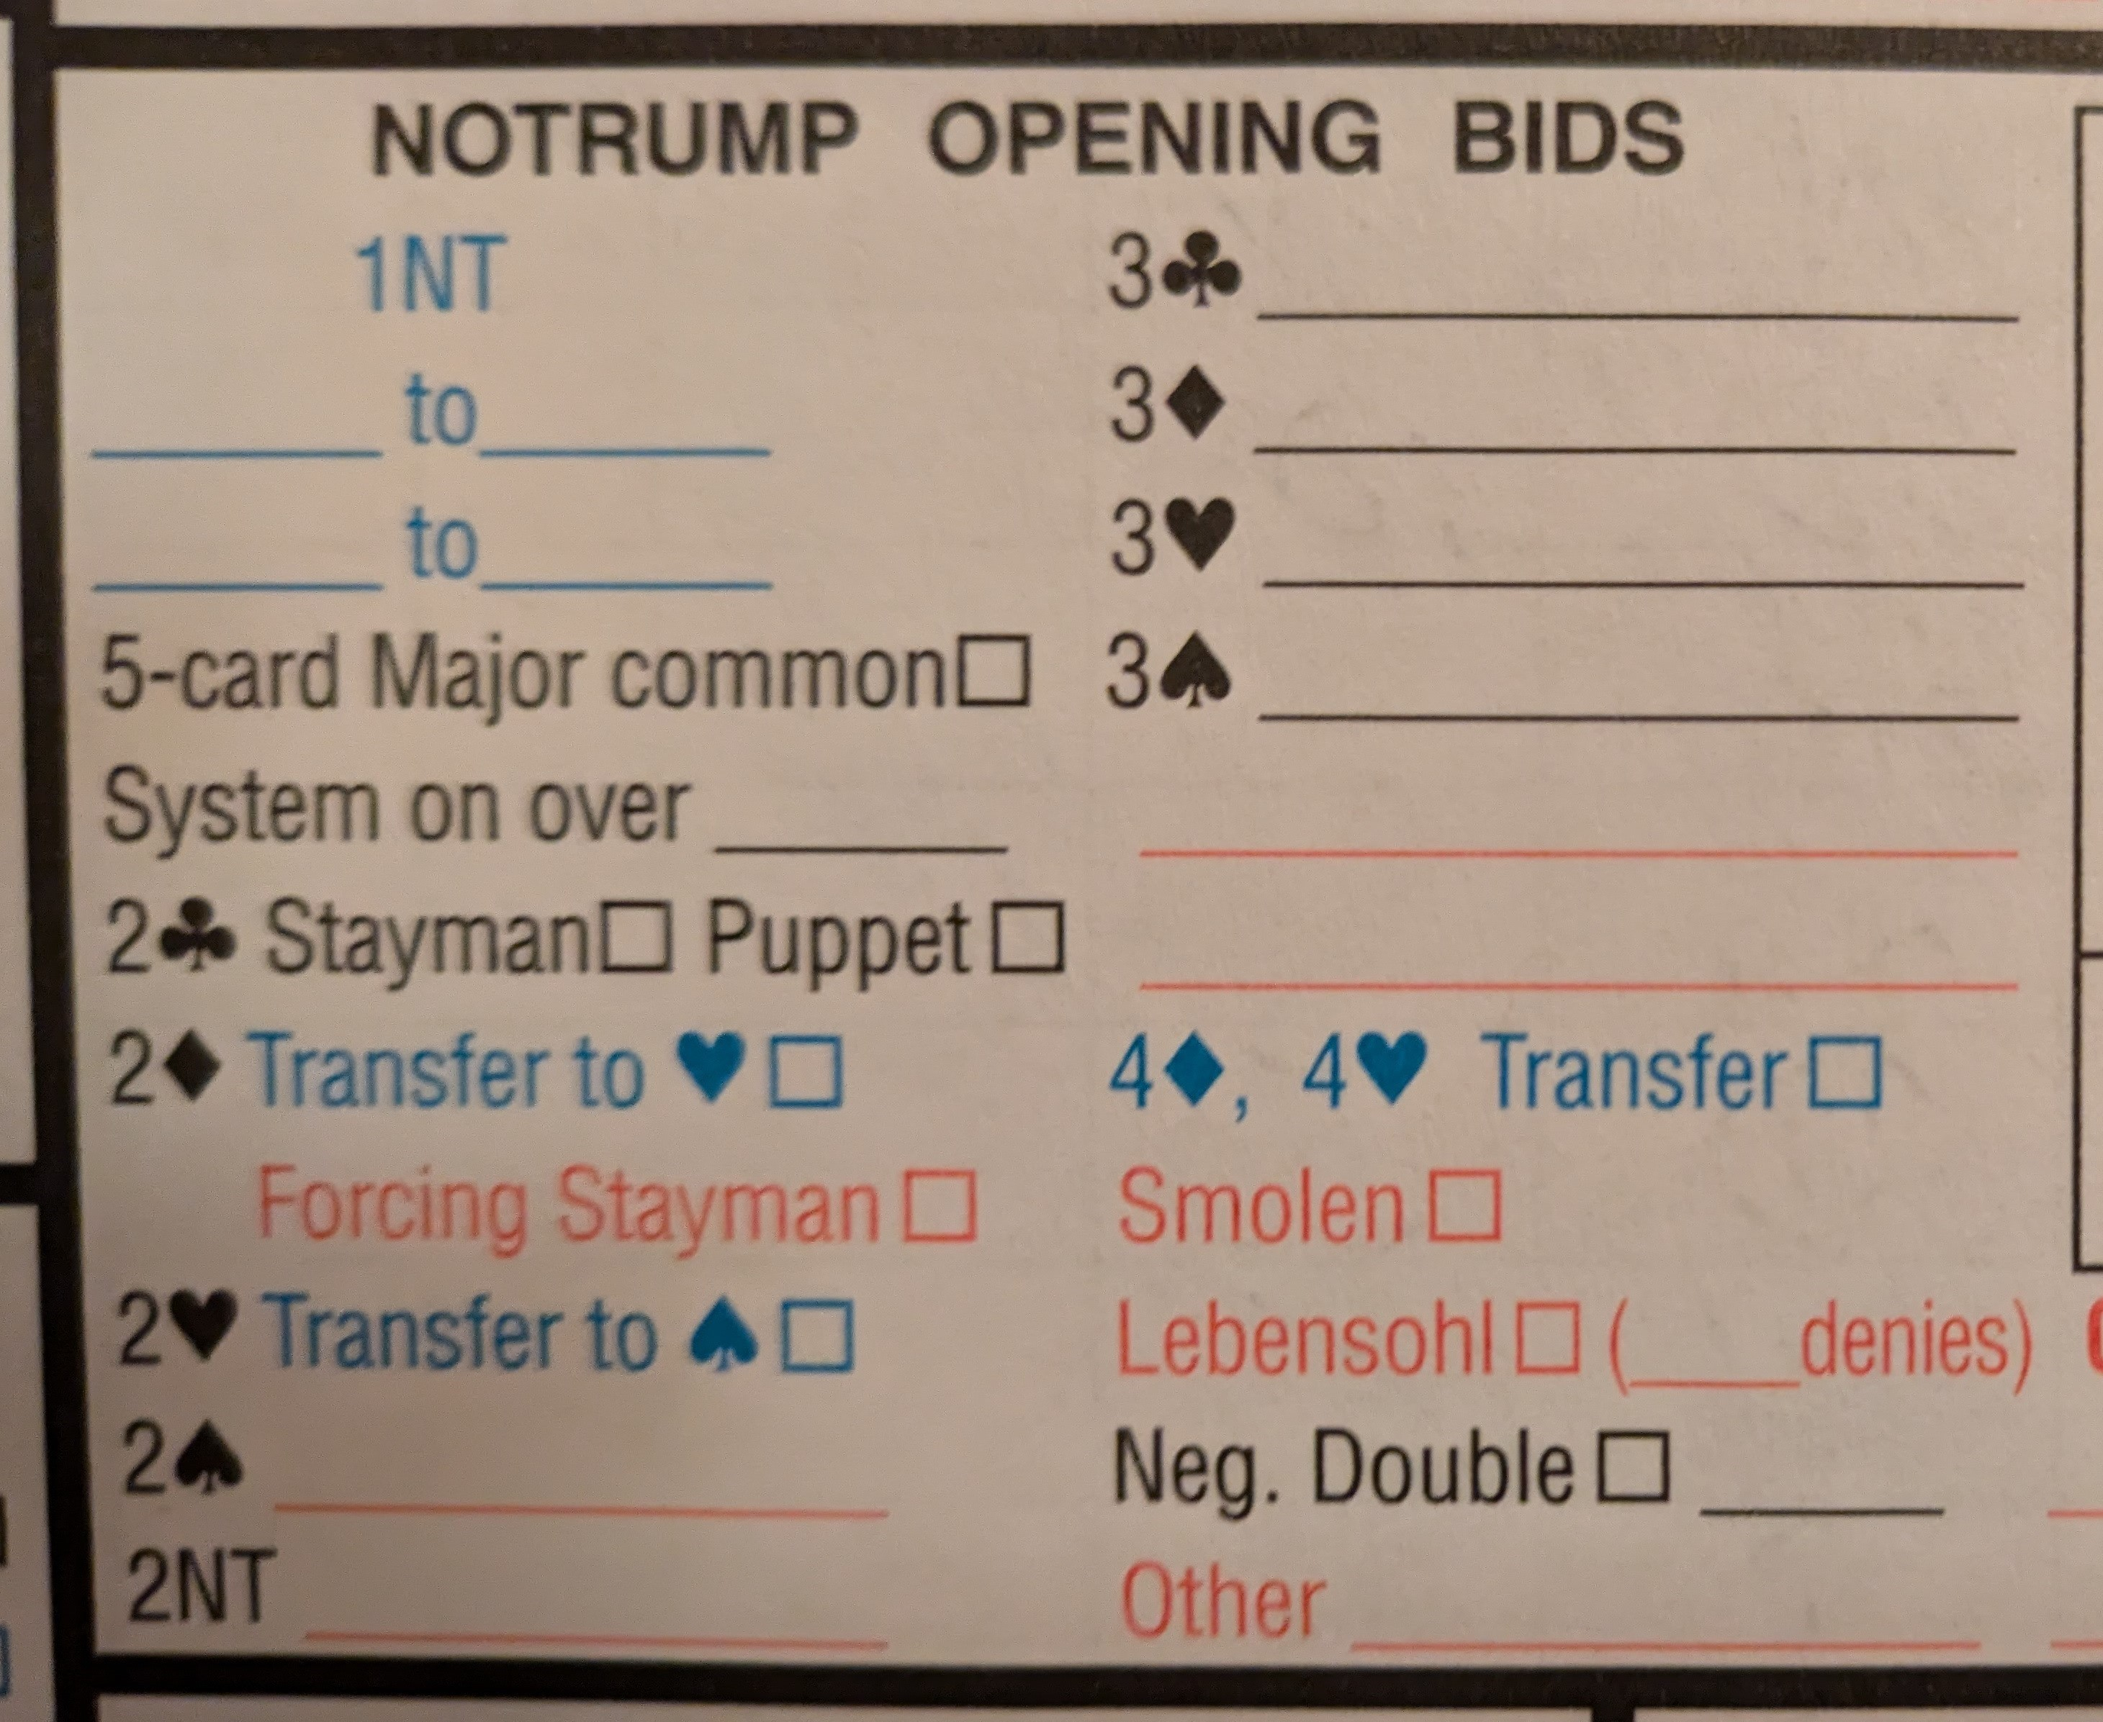
Your Convention Card
What is the meaning of 3C, 3D, 3H, or 3S in response to partner’s 1NT opener?
Have an agreement with your partner how you will use these bids.
Let’s look at some options.

Slide 3
Three Options
5/5 Majors/Minors
Puppet Stayman
Fragments

Slide 4
5/5 Majors/Minors
3C = 5/5 Minors Non-forcing
Partner can pass 3C or correct to 3D
3D = 5/5 Minors Forcing
Forcing one round. Possible responses include 3NT, 4m, or 5m
Responder with extras can still pursue slam with a quantitative or ace-asking bid

Slide 5
5/5 Majors/Minors
3H = 5/5 Majors Invitational
Partner can—
pass 3H
correct to 3S
bid game in NT or one of the majors to accept the invitation
3S = 5/5 Majors Game Forcing
Partner bids game in either a major or NT
Responder with extras can still pursue slam with a quantitative or ace-asking bid

Slide 6
Examples
1NT—3C
  x
  xx
  Kxxxx
  Axxxx
1NT—3D
  x
  Qx
  KQxxx
  Axxxx
1NT—3H
  Kxxxx
  KJxxx
  xx
  x
1NT—3S
  Axxxx
  KJxxx
  Jx
  x

Slide 7
Puppet Stayman
3C = Puppet Stayman
Asks opener if they have a 4 or 5-card major
Give up the 5/5 minors weak bid
3D = 5/5 Minors Forcing (same)
Forcing one round. Possible responses include 3NT, 4m, or 5m
Responder with extras can still pursue slam with a quantitative or ace-asking bid

Slide 8
Puppet Stayman
3H = 5/5 Majors Invitational (same)
Partner can—
pass 3H
correct to 3S
bid game in NT or one of the majors to accept the invitation
3S = 5/5 Majors Game Forcing (same)
Partner bids game in either a major or NT
Responder with extras can still pursue slam with a quantitative or ace-asking bid

Slide 9
Responses to Puppet Stayman
1NT—3C
  3D = one or both 4-card majors
    3H/3S = responder bids the major they DO NOT have and opener places the contract
    3NT = responder was looking for a 5-card major
    4D = responder has both majors 4/4, opener places the contract
  3H = 5 hearts
    3NT = responder was not looking for hearts
    4H = found a fit
  3S = 5 spades
    3NT = responder was not looking for spades
    4S = found a fit
  3NT = no 4 or 5-card major
  Responder with a good hand can go on to ask for aces or make a quantitative bid

Slide 10
Examples
1NT—3C—3D—3H
  AJxx
  Qxx
  Kxxx
  Jx
1NT—3C—3H—3NT
  Kxx
  Jx
  Axxx
  QJxx
1NT—3C—3D—4D
  KQxx
  QJxx
  A
  KJxx
1NT—3C—3S—4S
  Kxx
  Jx
  QJxx
  AJTx

Slide 11
Fragments
3C = 5/5 Minors Non-forcing or Puppet Stayman
Partnership agreement
3D = 5/5 Minors Forcing (same)
Forcing one round. Possible responses include 3NT, 4m, or 5m
Responder with extras can still pursue slam with a quantitative or ace-asking bid

Slide 12
Fragments
3H = 3-1-5/4 (singleton heart)
Partner can—
bid 3NT with stoppers in hearts
bid 4S with 5 spades
raise one of the minors
3S = 1-3-5/4 (singleton spade)
Partner can—
bid 3NT with stoppers in spades
bid 4H with 5 hearts
raise one of the minors

Slide 13
Examples
1NT—3H—3NT
  Responder’s hand:
    Qxx
    X
    AJxx
    KQxxx
  Opener’s hand:
    AJx
    AQJx
    Kxx
    Jxx
1NT—3S—4D
  Responder’s hand
    x
    Qxx
    AJxx
    KQxxx
  Opener’s hand:
    Jxx
    KJx
    KQxx
    AJx

